Slide 1

QSAR Challenge: Predicting Molecular activity from Smiles
Lukas Steu
UE Artificial intelligence in life sciences
Goal: predict biological activity for 11 tasks from molecular structure

Slide 2
The Problem
What is the problem?
  Predict biological activity or toxicity from a molecule’s structure
Who has this problem?
  Me, pharma and biotech companies
Why should this problem be solved?
  Can accelerate drug discovery and reduce unnecessary experiments
How will I know this problem has been solved?
  When the model performs well on unseen test molecules

Slide 3
Background Information
QSAR = Quantative Structure-Activity Relationship
  Input: molecule as SMILES String
  Output: activity prediction for 11 tasks
  Label meaning
    +1 = active
    -1 = inactive
    0 = unknown
    Importance: unknown labels are NOT negative labels and must be ignored per task

Slide 4
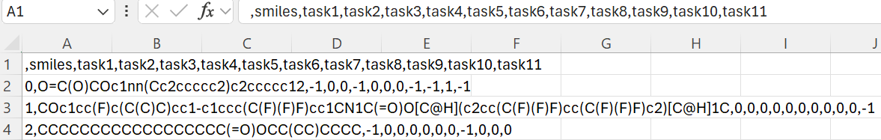
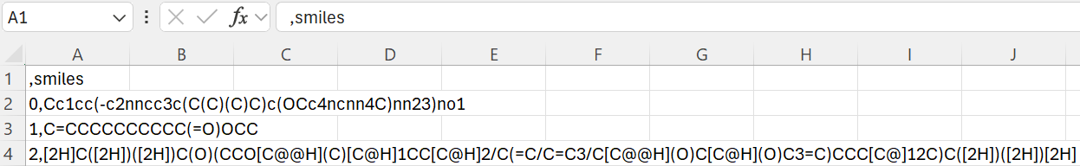
Dataset and challenge setup
Training data:
  SMILES + 11 Task Labels
Test data:
  SMILES only
Submission:
  One score per task and molecule
Evaluation:
  Mean ROC-AUC across tasks
  Unknown labels masked out

Slide 5
Data preprocessing and Representation
SMILES parsed with RDKit
Molecules represented by:
  Morgan fingerprints
    Caputre local substructures, widely used QSAR baseline, robust and fast
  Optional RDKit descriptors
    Gobal chemical properties: molecular weight, logP, TPSA, H-bond donors/acceptors etc.
Invalid molecules were not removed
Fallback strategy used to preserve all rows

Slide 6
Modeling Strategy
Treated as 11 separate binary classification tasks
For each task:
  Keep only known labels
  Map +1 to 1 and -1 to 0
  Train one classifier
Baseline models tested:
  Logistic Regression, ExtraTrees and Random Forest
  Why: simple, robust, easy handling of missing labels and (at least for me) easy to use ☺
Prediction:
  Use probability scores, not hard class labels

Slide 7
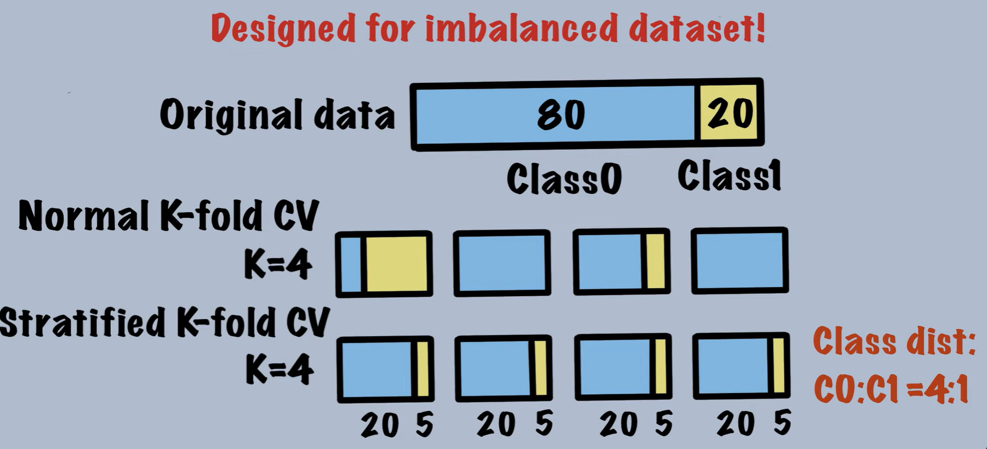
Validation Strategy
Used Stratified K-Fold Cross-Validation
  Imbalanced dataset
Generated out-of-fold predictions (OOF)
Computed AUC per task
Final score = mean AUC across tasks
Stratified vs Normal K-Fold
Source: https://www.youtube.com/watch?v=mMKyljcoaCE

Slide 8
Results
Logistic Regression
ExtraTrees
Random Forests
  Features:
    Morgan + descriptors
    Radius: 2 & bits: 2048
  Mean OOF AUC
    0.75622
  Runtime
    27s
  Features:
    Morgan + descriptors
    Radius: 2 & bits: 2048
  Mean OOF AUC
    0.76250
  Runtime:
    3m 10s
  Features:
    Morgan + descriptors
    Radius: 2 & bits: 2048
  Mean OOF AUC
    0.78053
  Runtime:
    1m 53s

Slide 9
Key findings & interpretation
Morgan fingerprints provide a strong baseline for QSAR
handling missing labels correctly is crucial
simple models can already achieve competitive AUC
some tasks are easier than others, likely due to data quantity or separability
descriptors help, but their effect should be validated empirically

Slide 10
Limitations & Future work
Limitations:
  Random CV may overestimate generalization in QSAR
  Class imbalance can affect training stability
  Fixed fingerprints may lose some structural nuance
  Separate task models do not exploit task correlations
Future Work:
  Scaffold based validation
  Hyperparameter tuning
  Model ensembling
  Gradient boosting methods
  Graph neural networks / message passing networks

